Slide 1
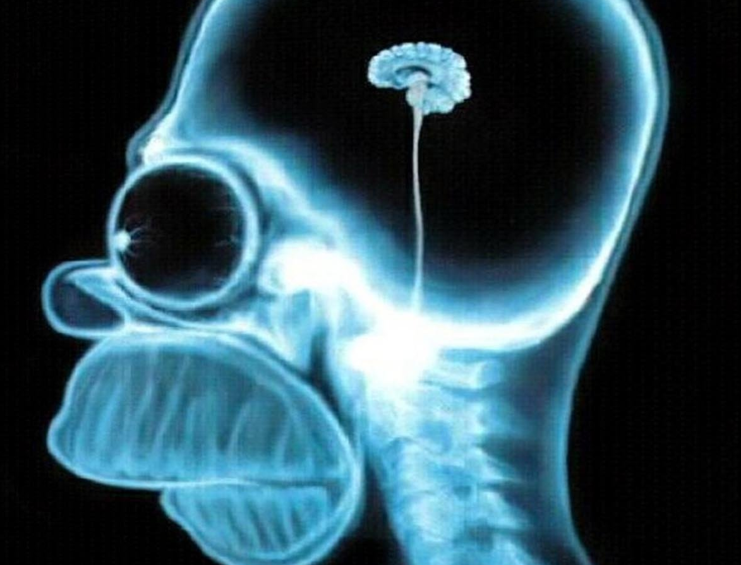

Brain Bleed
Kiet V. Vo, MD (PGY-3)
vokv@uw.edu
https://www.amazon.co.uk/Rainbow-Artworks-Homer-Simpson-Brain-Xray-The-Simpsons-Canvas-Print/dp/B01N3MJ2BZ
Special thanks to and adapted from original lectures of Drs. Jonathan Medverd, Kathleen Fink, Aaron Rutman, Jason Hartman, and Richa Patel

Slide 2
Goals & Objectives
Understand indications for acute head imaging
Review basic neuroanatomy
Identify traumatic pathology
Review cases

Slide 3
Goals & Objectives
Understand indications for acute head imaging
Review basic neuroanatomy
Identify traumatic pathology
Review cases

Slide 4
Which study?
Acute change
Acute mental status change:
  FIRST STUDY IS [almost] ALWAYS noncon-head CT
Brain MR:
  Stroke protocol (noncontrast)
  ICH protocol (with contrast)
  Tumor protocol (with contrast)

Slide 5
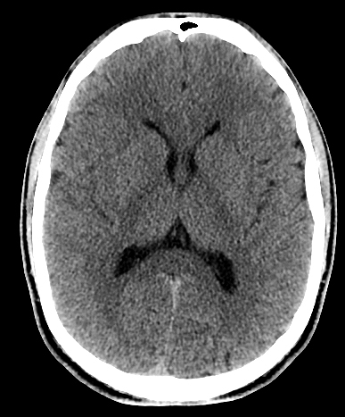
Noncontrast Head CT
Why CT?
  Widely available
  Fast (a few seconds!)
  Best for detecting acute blood
  Best for bony detail/fracture detection
Why no contrast?
  Goal is to detect blood (bright)
  Bright contrast is a confounder
Notes:
-CT is available everywhere, in big cities and rural hospitals
-It is very fast—a head CT only takes a few seconds
-And it’s best for seeing acute blood (as well as fractures)
Note that we don’t want any contrast here. We’re looking for acute blood, which will be bright. Using contrast adds bright stuff into the vessels—which is a confounder---it can make it harder to know if there is acute blood, or just contrast in the vessels

Slide 6
Code Stroke!
What am I looking for?
  Is there blood???
Why do I care—what decision do I have to make?
  Do I treat the patient or not?
  tPA (tissue plasminogen activator)
    Clot buster medication
    Blood on CT: do not give TPA
    No blood on CT: give TPA
Notes:
--And that’s the main reason we do the noncon head CT. We’re looking for acute blood!
--The presence or absence of blood will decide whether or not I can treat the patient with tPA
--If I think the patient is having a stroke, it doesn’t matter if I can see infarcted tissue yet, because infarcted tissue can take hours to declare itself
--If there is no blood, I will treat with clot busting medication tPA
--If there is blood, I will not treat—tPA can worsen the hemorrhage

Slide 7
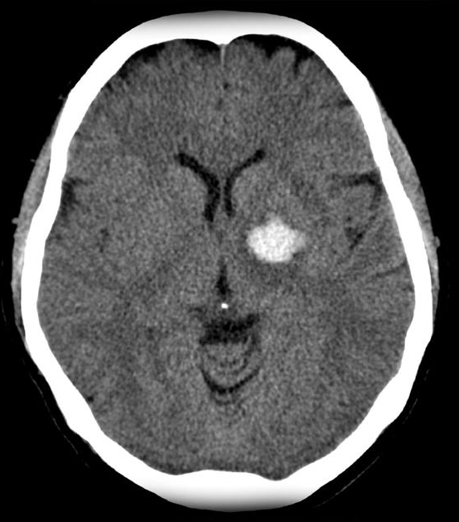
Code Stroke
Is there blood?
No
Yes
Notes:
At UW, stroke code team consists of the ED physician, the consulting neurologist, and the radiologist. Additionally, the interventional neuroradiology team are notified of a stroke code, in case an intervention needs to be made (a thrombectomy).
As soon as the noncontrast CT is performed, the radiologist reads the images and consults with the team on next steps.
The first question to answer is: “Is there blood in the brain?”

Slide 8
Code Stroke
Patient brought in with 1 hour of aphasia and right facial droop. The initial head CT is negative.
Next step in imaging:
  CTA
  MRI
  Carotid Ultrasound
  What am I looking for?
Notes:
Here is another case. A patient is brought in with 1 hour of aphasia and facial droop. So the patient is still in the stroke window. The initial head CT is negative—you don’t see any blood or any other abnormalities.
What is the next step? Think about what you are looking for—the patient is having clear stroke symptoms, so even though you don’t see anything on the noncontrast head CT, you are worried that the patient is having a stroke.
The answer is CTA! Although an MRI would certainly be helpful to diagnose the extent of the stroke, it will take far too long to get the patient out of CT and into the MRI scanner, and then it will take another 20 minutes of imaging to acquire the images. Remember, this patient is in the window, and “time is brain”. The patient is already on the CT table and got an IV on the way to CT. So we can do a CT angiogram in a matter of a couple minutes, which can give us some crucial information.
Carotid Ultrasound will help us very little in this situation. It is good for evaluating carotid atherosclerosis and gives us a good idea of the patient’s stroke risk due to carotid plaque, but does not help us acutely.

Slide 9
Code Stroke
Patient brought in with 1 hour of aphasia and right facial droop. The initial head CT is negative.
Next step in imaging:
  CTA
  MRI
  Carotid Ultrasound
  What am I looking for?
Notes:
A patient is brought in with 1 hour of aphasia and facial droop. So the patient is still in the stroke window. The initial head CT is negative—you don’t see any blood or any other abnormalities.
What is the next step? Think about what you are looking for—the patient is having clear stroke symptoms, so even though you don’t see anything on the noncontrast head CT, you are worried that the patient is having a stroke.
The answer is CTA! Although an MRI would certainly be helpful to diagnose the extent of the stroke, it will take far too long to get the patient out of CT and into the MRI scanner, and then it will take another 20 minutes of imaging to acquire the images. Remember, this patient is in the window, and “time is brain”. The patient is already on the CT table and got an IV on the way to CT. So we can do a CT angiogram in a matter of a couple minutes, which can give us some crucial information.
Carotid Ultrasound will help us very little in this situation. It is good for evaluating carotid atherosclerosis and gives us a good idea of the patient’s stroke risk due to carotid plaque, but does not help us acutely.

Slide 10
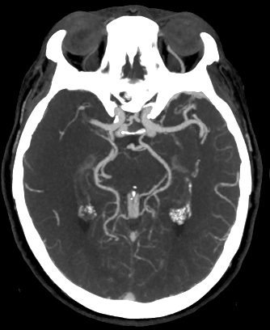
CT Angiography (CTA)
CTA Head and Neck
What am I looking for?
  Occlusion/Thrombus
    Thrombectomy?
  Cause of infarct
    Critical stenosis
      Atherosclerosis
      Vasculopathy
    Dissection
Notes:
In this situation (presumed ischemic infarct), we are going to do a CTA of the head and neck.
The most important thing that we are looking for is a large arterial occlusion in the central arteries of the Circle of Willis. This image shows a clot occluding the right MCA, a potentially devastating if not fatal situation if the clot cannot be busted mechanically or chemically (tPA)
Why do we care?
Because this is one of the reasons why a stroke code is called! If there is a clot in a large central artery occluding flow and causing the infarct, we can go in and take out the clot. This is done by Interventional neuroradiologists and increasingly by vascular neurosurgeons. If flow can be restored, it can save brain tissue that would otherwise die, drastically decreasing morbidity and mortality.
If there is no definite clot in the larger arteries (we cannot usually see tiny clots in smaller arteries), then our next step is to look for another reason for the stroke. This is why we do angiography of both the head and the neck when evaluating strokes—pathology in the carotid and vertebral arteries are important etiologies for ischemic infarct. Atherosclerosis may cause critical stenosis. More rarely vasculitis or other vasculopathies can restrict flow. Another important thing that happens in the neck vessels is dissection (in which the intima of the vessel is disrupted, and may lead to vessel occlusion or thrombosis).

Slide 11
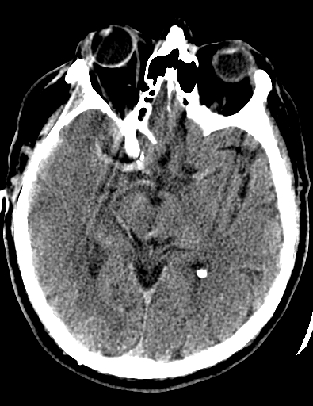
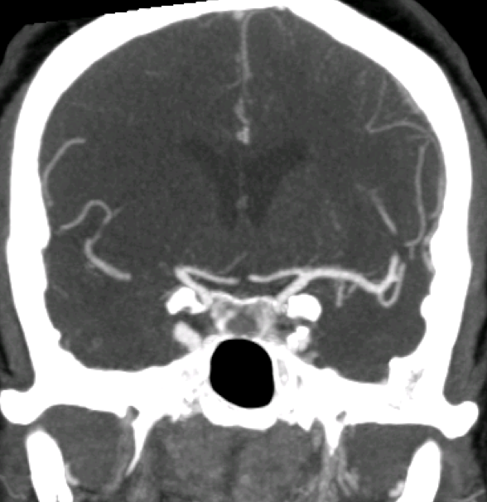
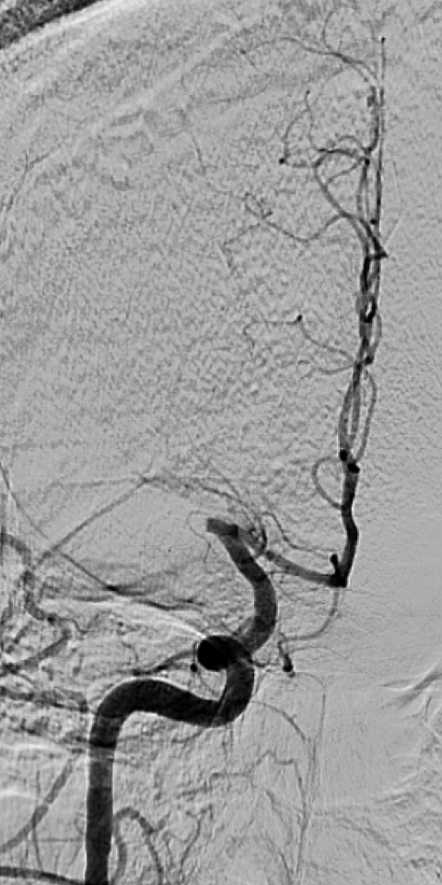
Large Vessel Occlusion
Important to identify right away -- trying to find a treatable clot is why a stroke code is called!
Notes:
This is an example of a large vessel occlusion.
--On the left image (an axial noncontrast CT) you can see the bright, hyperdense clot in the right MCA.
--The middle image is a coronal CTA of the head. You can see the lack of contrast filling the right MCA (if anyone wonders, the contrast enhancement distal to the occlusion in some of the MCA branches is due to collateral flow).
--The image on the right is from an AP catheter angiogram. The right ICA was injected. You can see that flow stops at the origin of the right MCA, while there is normal flow in the ACA

Slide 12
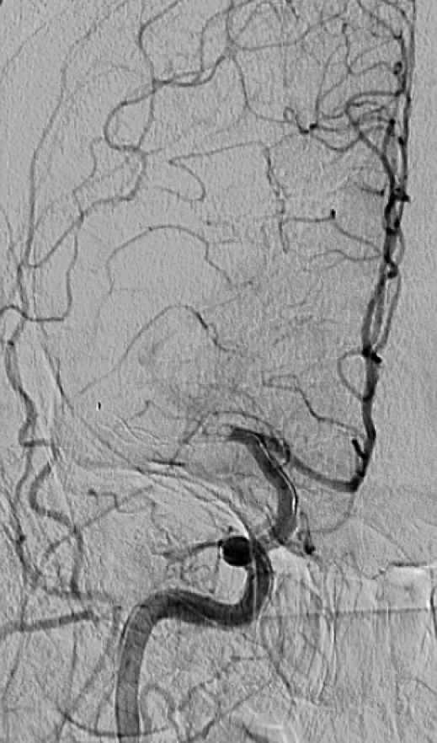
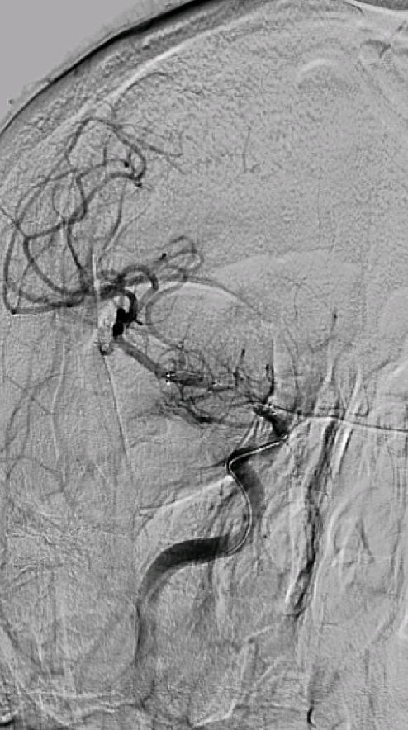
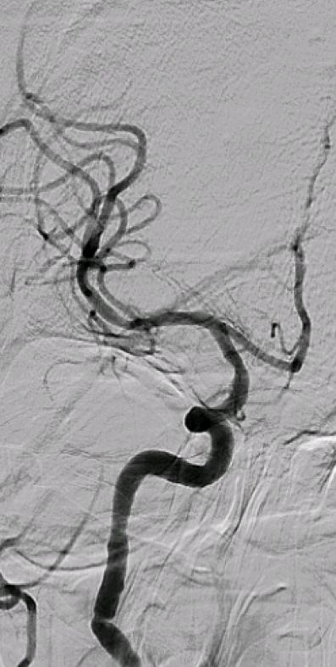
Thrombectomy
Notes:
These are subsequent images from the same case.
You can faintly see the microcatheter that the neurointerventionalist has snaked up through the femoral artery, all the way into the distal internal carotid artery. On the tip of the catheter is an expandable wire cage. The catheter is passed across the soft clot, and then the cage is expanded within the clot, and suction applied through the catheter, hopefully sucking out most of the clot.
The second image shows the catheter in place, with some slight restoration of flow in the MCA (notice the lenticulostriate arteries).
The 3rd image shows complete restoration of MCA flow after clot retrieval. Saving brain, saving lives!

Slide 13
Why?
Modality | CT | MR
J | Cheap Fast Fractures easily seen | Sensitive to blood Sensitive to subtle pathology (DAI)
L | Not so sensitive to subtle pathology | Expensive Slow Fractures not well seen

Slide 14
Which study?
Vascular
CTA:
  CTA Neck: Aortic arch through Circle of Willis.
  CTA Head: Circle of Willis only
MRA:
  MRA Brain: non-contrast
  MRA Neck: without and with contrast.

Slide 15
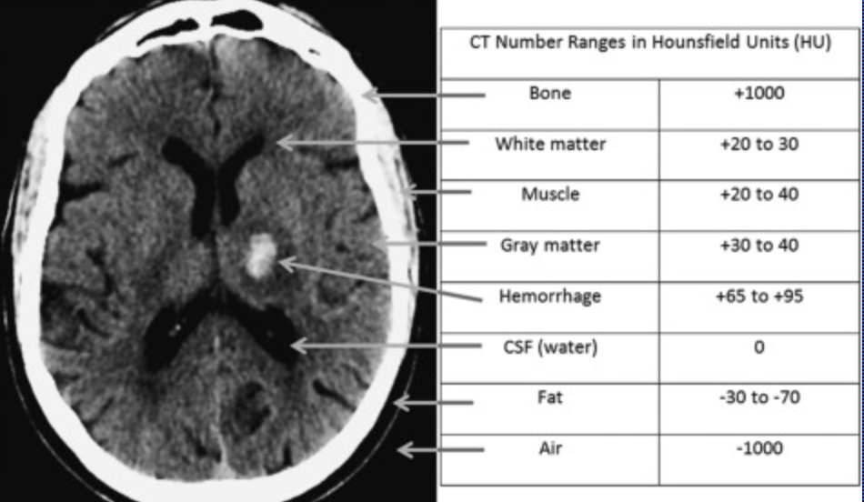
Hounsfield Units (HU)

Slide 16
Goals & Objectives
Understand indications for acute head imaging
Review basic neuroanatomy
Identify traumatic pathology
Review cases

Slide 17
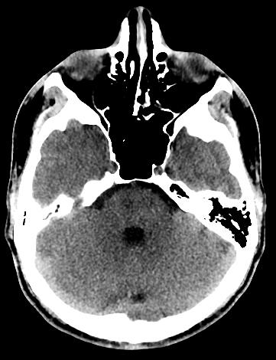
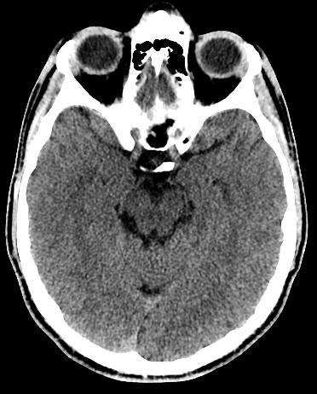
Normal Noncon Head CT
1 = fourth ventricle
2 = middle cranial fossa
3 = pons
* = basal cisterns
4 = cerebellum
5 = occipital lobe
6 = temporal lobe
→ = transverse sinus
2
*
3
6
*
1
4
5
Patient’s: RIGHT
LEFT
Notes:
17

Slide 18
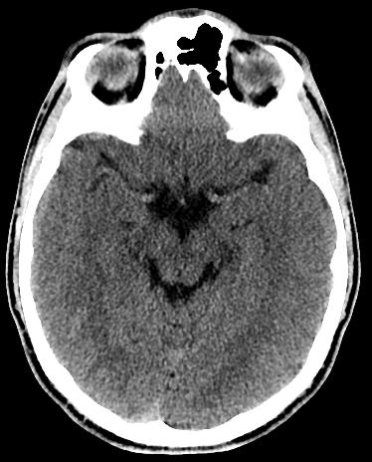
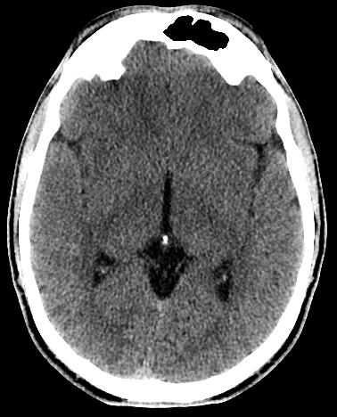
Normal Noncon Head CT
* = MCA
1 = frontal lobe
2 = temporal lobe
3 = occipital lobe
4 = parietal lobe
5 = thalamus
6 = lentiform nucleus
7 = atrium of lateral ventricle
1
*
6
*
5
2
7
4
3
3
Notes:
18
Note midline shift to the left!
putamen and the globus pallidus

Slide 19

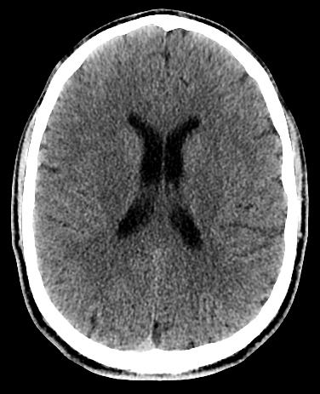
Normal Noncon Head CT
1 = frontal horn of lat. ventricle
2 = caudate nucleus
3 = lentiform nucleus
4 = thalamus
5 = septum pellucidum
6 = cerebral falx
1
2
5
3
4
6
Notes:
19
Lentiform nucleus = putamen and globus pallidus

Slide 20
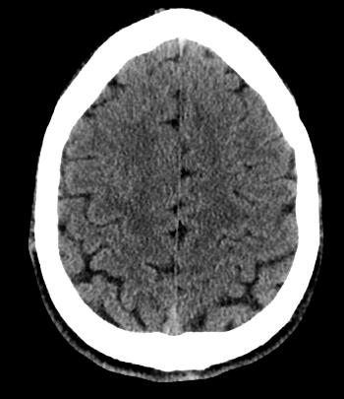
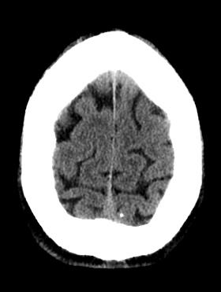
Normal Noncon Head CT
1 = frontal lobes
2 = parietal lobes
3 = superior sagittal sinus
3
1
1
3
2
2
3
Notes:
20

Slide 21
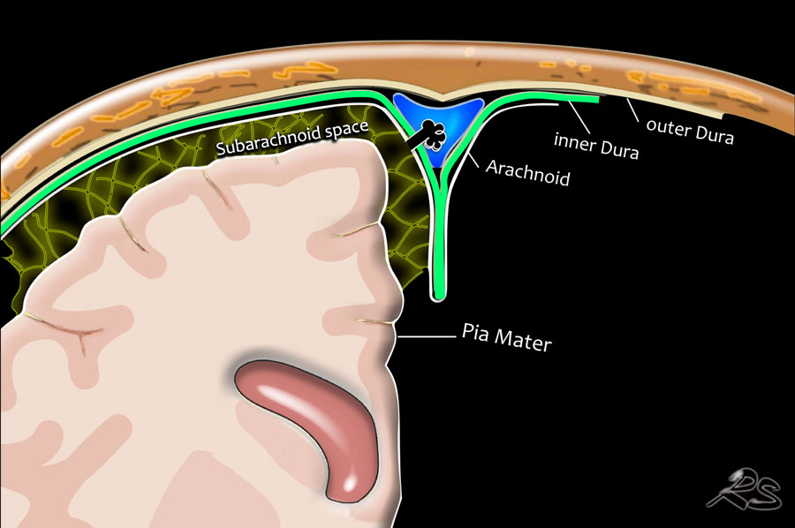

Slide 22
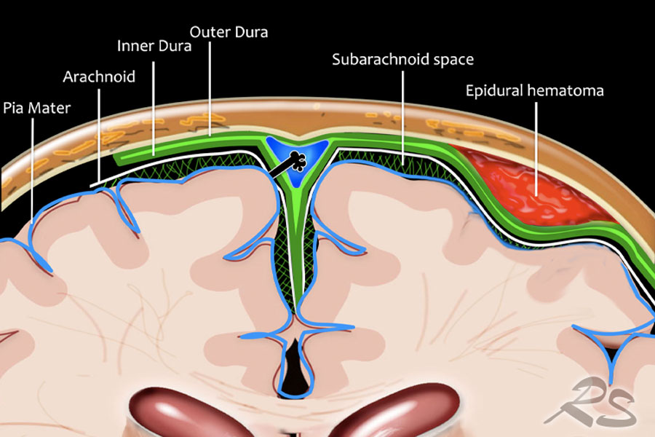

Slide 23
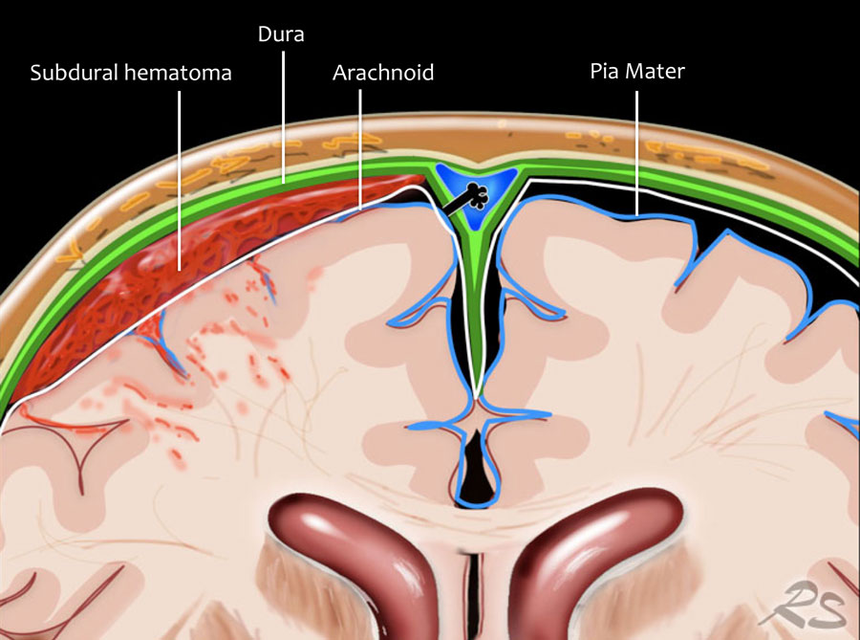

Slide 24
Goals & Objectives
Understand indications for acute head imaging
Review basic neuroanatomy
Identify traumatic pathology
Review cases

Slide 25
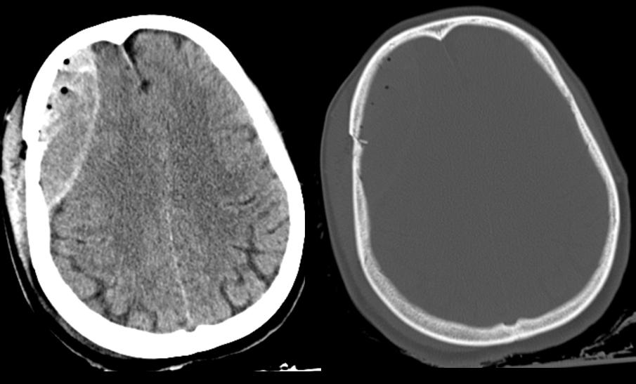
Diagnosis?

Slide 26
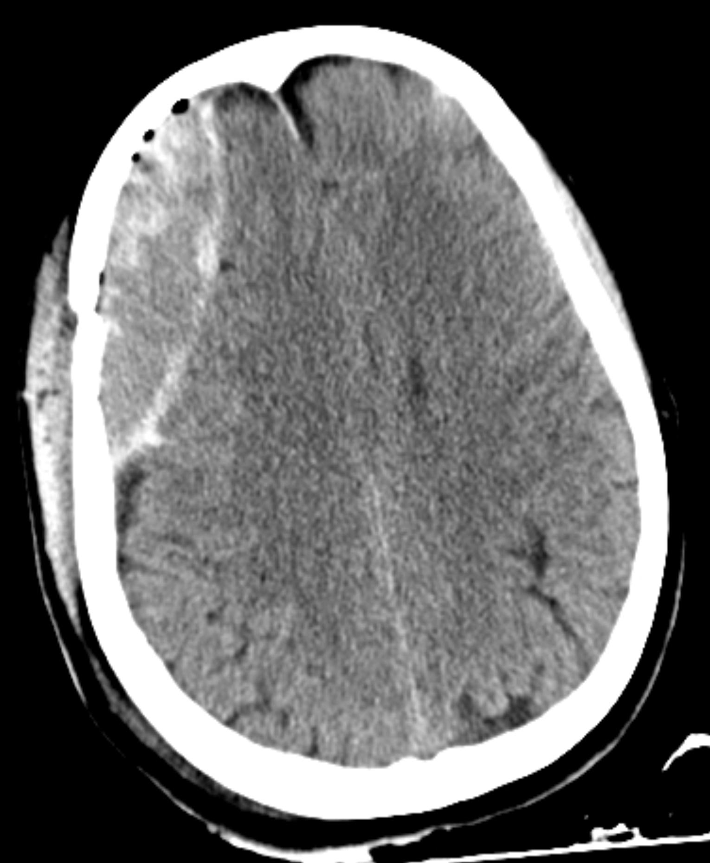
Epidural Hematoma
Lucid period after initial insult
Injury to epidural vessel
  Usually middle meningeal artery
Lentiform (lens) shaped
Do not cross sutures
  May cross falx or tentorium
Look for:
  SKULL FRACTURE
  RAPID EXPANSION 2/2 arterial bleed

Slide 27
Step Review
The middle meningeal artery arises from which branch?
External carotid artery
Middle cerebral artery
Maxillary artery
Posterior cerebral artery

Slide 28
Step Review
The middle meningeal artery arises from which branch?
External carotid artery
Middle cerebral artery
Maxillary artery
Posterior cerebral artery

Slide 29
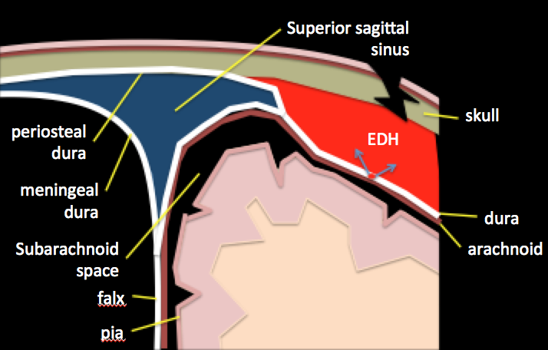
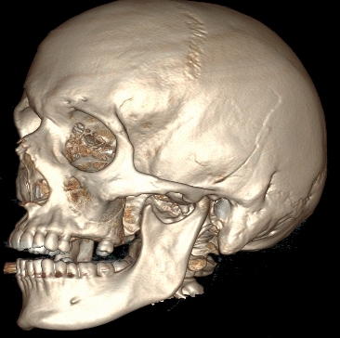
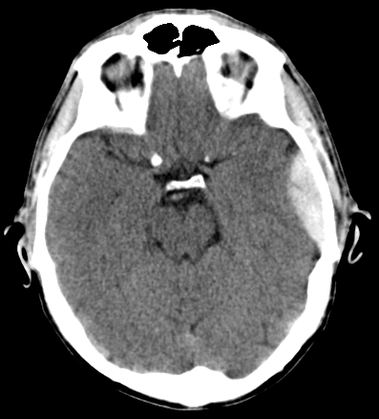
Epidural Hematoma
skull fracture
lucid period
Middle meningeal artery
Lens-shaped
Notes:
This schematic might help you understand how skull fracture and meningeal vessel injury predispose to epidural hematoma formation
--The epidural space is a potential space which does not exist in normal individuals—the dura is normally intimately associated with the periosteum of the skull.
--A fracture may injure a meningeal vessel (the middle meningeal artery is the largest of the meningeal vessels), and the high arterial pressure bleeding peels the dura off of the skull, creating a hematoma in the epidural space.
--These generally do not cross sutures, as the dura is more tightly bound to the skull at the sutures. This creates a more focal, lens shaped hematoma.
You may hear another buzz-word—the so-called “lucid period”—this refers to the fact that patients are generally lucid for a couple hours after the initial injury. This is because the brain itself is shielded from the noxious effects of the blood by the dura, so the patient may not experience significant neurologic symptoms initially. However, the arterial pressures lend to rapid accumulation of blood, with rapid destabilization and death due to brain herniation after the initial “lucid period”.

Slide 30
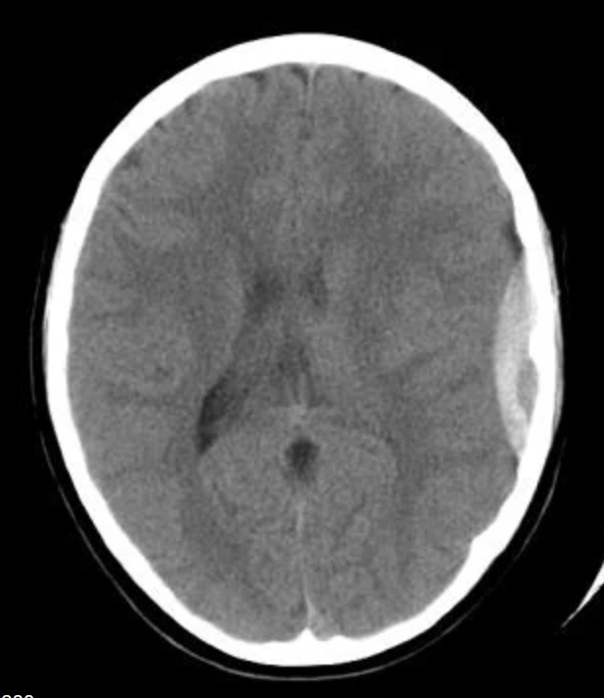
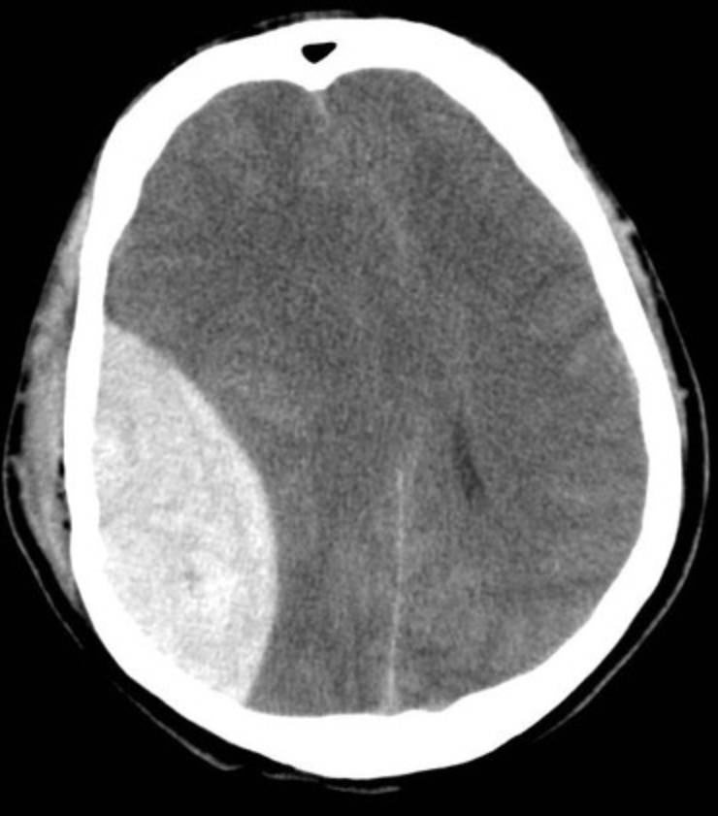
Epidural Hematoma

Slide 31
Epidural Hematoma

Slide 32
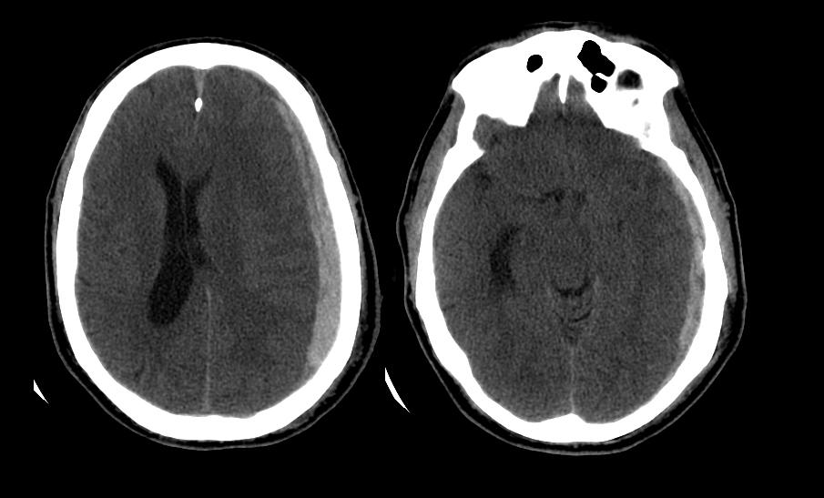
Diagnosis?

Slide 33
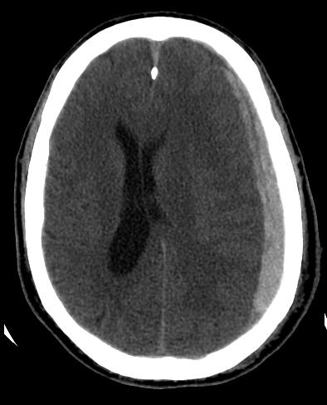
Acute Subdural Hematoma
Injury to bridging vessel
  ”Bridging cortical veins”
Crescent shaped
Pt: old/atrophied brain or chronic alcoholism, shaken baby
May cross sutures
  Does not cross falx or tentorium
Does not enter sulci
Watch for:
  MASS EFFECT
  SLOW EXPANSION

Slide 34
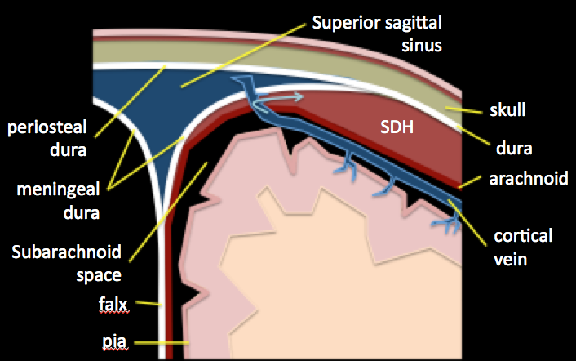
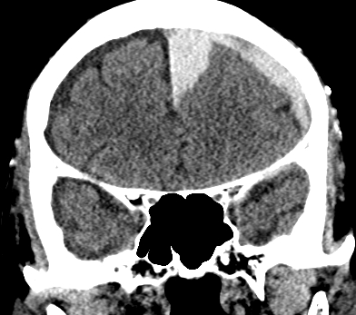
Subdural Hematoma
Slower venous bleed
Bridging cortical veins
Crescent shaped
Cannot cross the falx
Notes:
This schematic may help you understand how these subdural bleeds happen.
--As you know, venous blood in the brain drains via central and cortical veins which empty into the dural venous sinus system, which then empties into the jugular veins.
--These veins that empty into the dural sinuses have to cross from the subarachnoid space where they reside, across the arachnoid and dural layers. The attachment points where they cross are particularly susceptible to shearing and acceleration/deceleration forces.
--When the bridging veins tear, they bleed into the potential space between the arachnoid and dural layers (the subdural space)
--The bleeding is therefore venous (not arterial like epidural usually is)
--The shape of the hematoma is generally more crescent shaped as the blood can follow the contour around the entire brain hemisphere, and is not bounded by the dural suture attachments
--however, as it is subdural, it cannot cross the falx (see coronal CT, in which hematoma follows around the brain, and then medially along the falx, without crossing it).

Slide 35
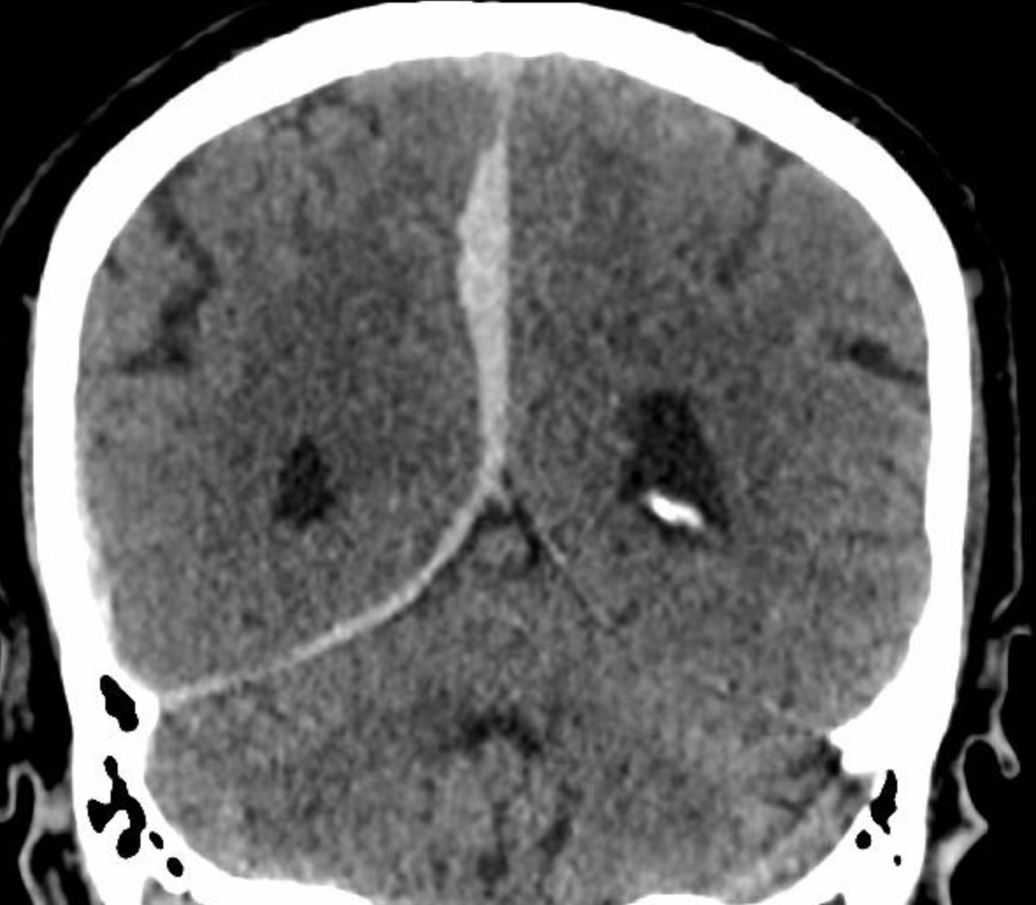
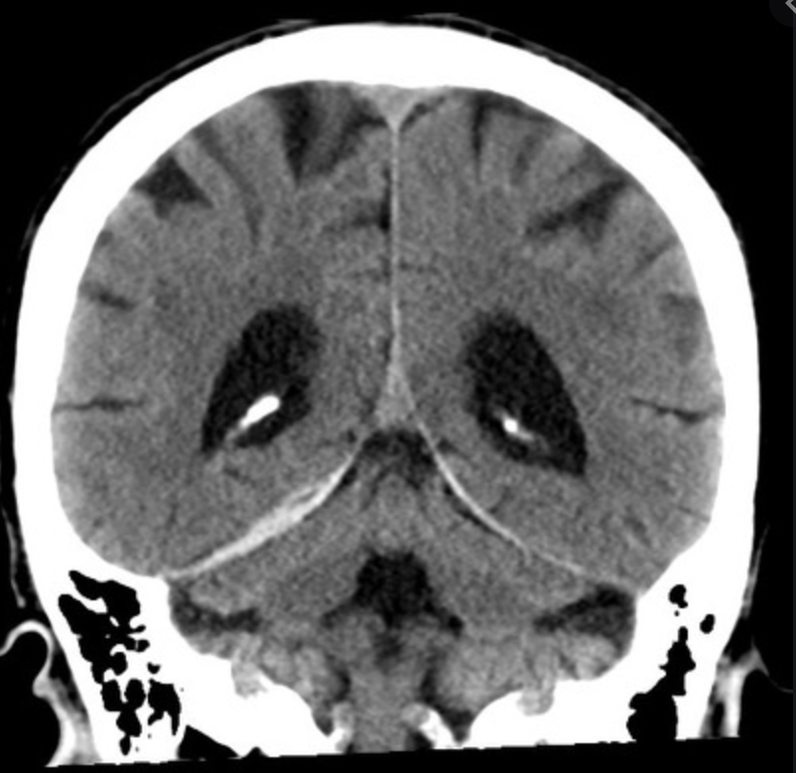
Acute Subdural Hematoma

Slide 36
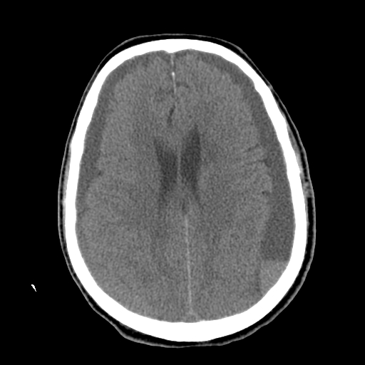
Diagnosis?

Slide 37
Chronic Subdural Hematoma
HYPODENSE
  (blood degradation)
MIXED
  (Acute-on-chronic)
Chronic
Acute

Slide 38
Acute on chronic subdural hematoma
Notes:
Heterogeneous appearance suggests acute on chronic bleed
- (dark chronic, bright acute)
Hematocrit effect on this study suggests clotting disorder or anticoagulation

Slide 39
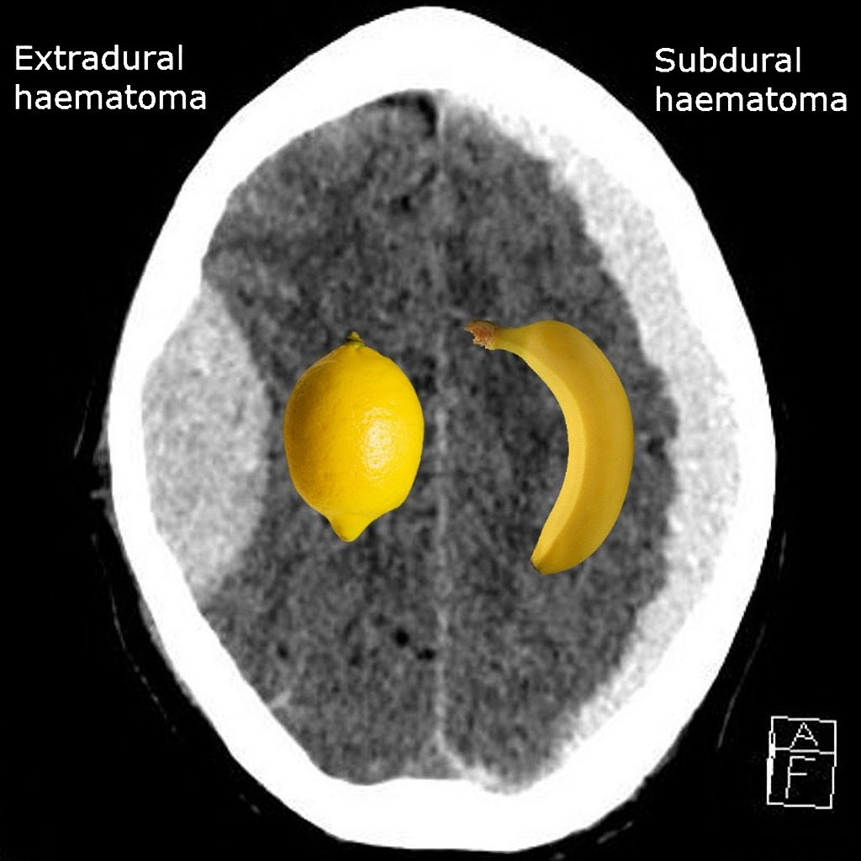
https://radiopaedia.org/cases/extradural-vs-subdural-haematoma-lemon-vs-banana?lang=us

Slide 40
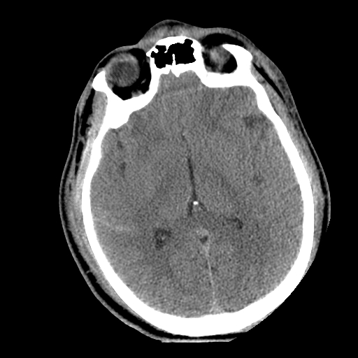
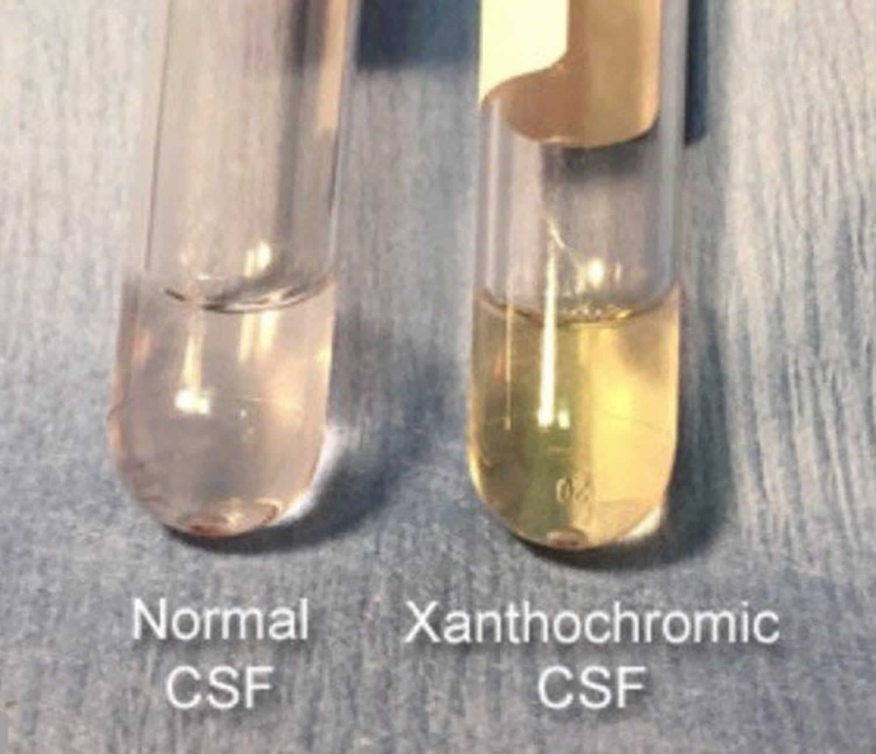
Diagnosis?
WHOML = worst headache of my life
Bloody or yellow (xanthochromic) lumbar puncture
Increased risk of developing communicating and/or obstructive hydrocephalus
https://healthjade.net/xanthochromia/
Notes:
Tends to appear as linear high attenuation in cisterns/sulci

Slide 41
Subarachnoid Hemorrhage
Subarachnoid
  Sulci
  Cisterns
  Ventricles
Trauma
  lateral convexities
Aneurysm
  basal cisterns
Interpeduncular Cistern
  most sensitive

Slide 42
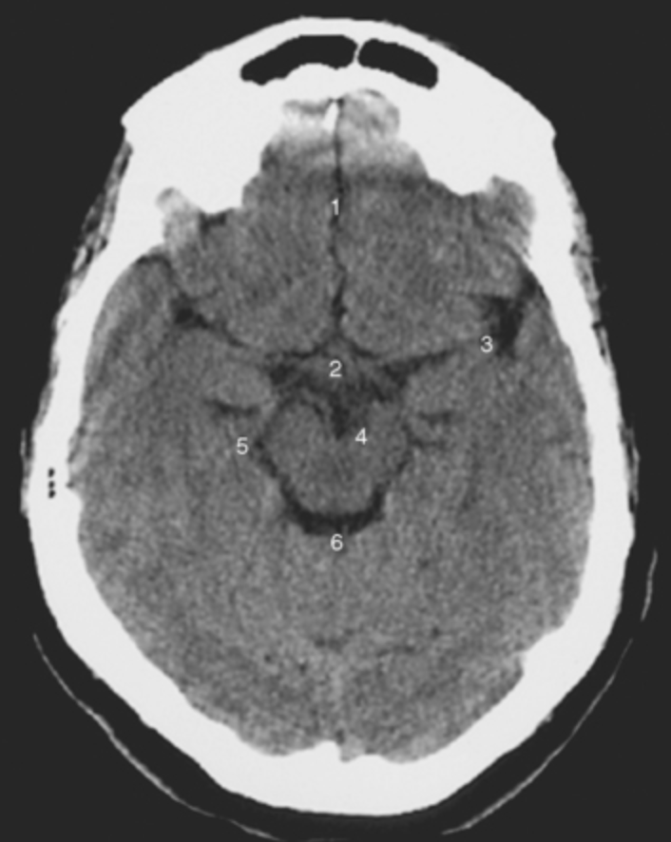
Interhemispheric fissure
Suprasellar Cistern
Sylvian Fissure
Interpeduncular cistern
Ambient cistern
Quadrigeminal cistern

Slide 43
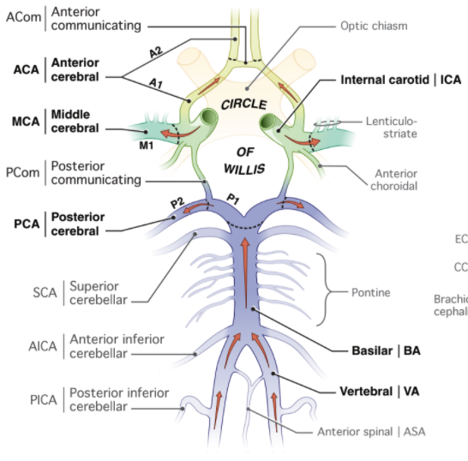
Step Review
1
4
2
3
5
6
Le T et al. USMLE Step 1, 20202. McGraw Hill. NY.

Slide 44
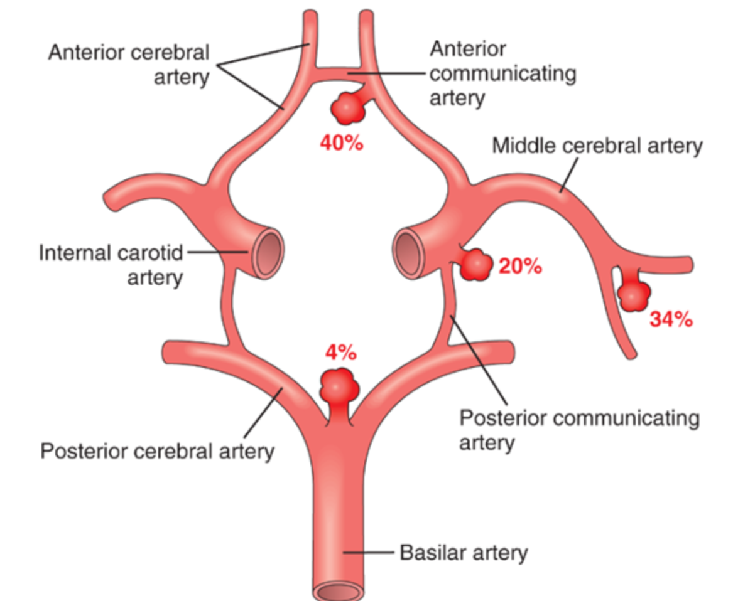
Notes:
ACOM
IC-PCom junction
MCA bifurcation
Basilar tip

Slide 45
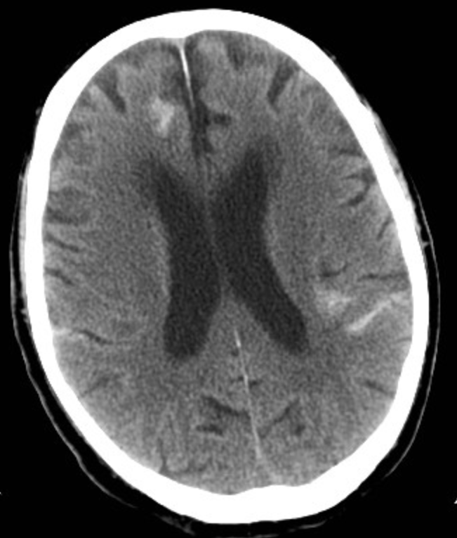
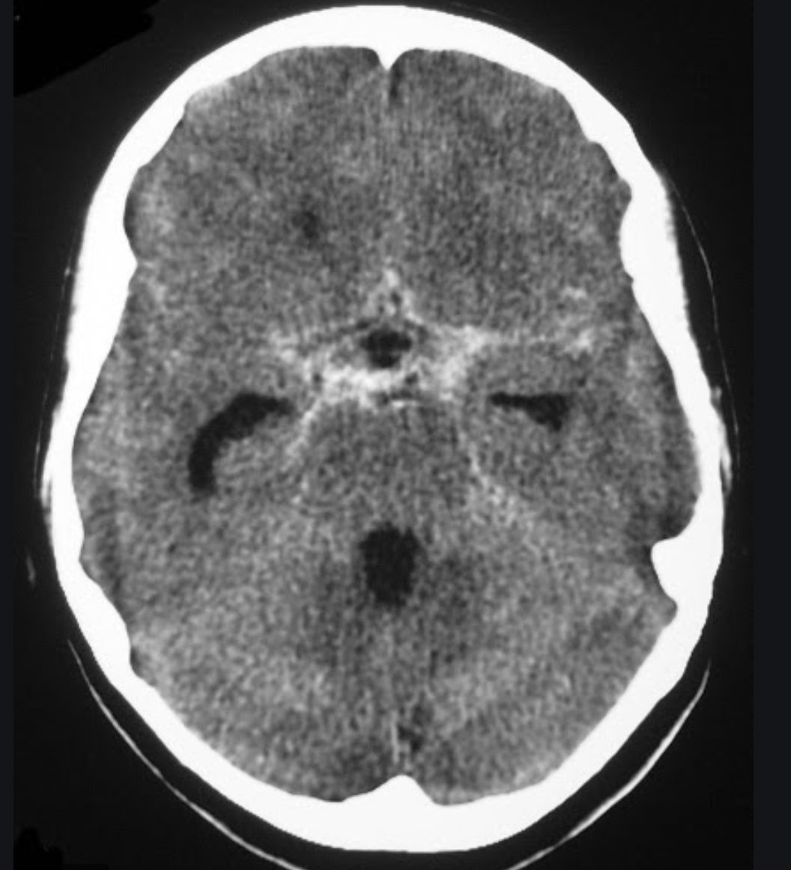
SAH

Slide 46
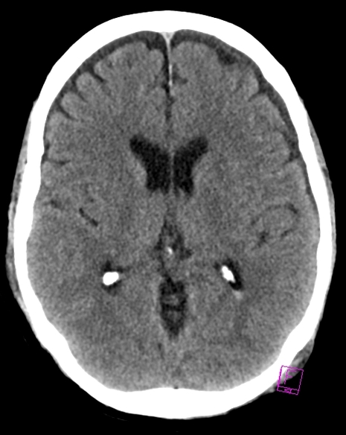
Diagnosis?

Slide 47
Intraventricular Hemorrhage
  May occur due to:
    Tearing of subependymal veins
    Direct extension
  Look for:
    layering in the occipital horns

Slide 48
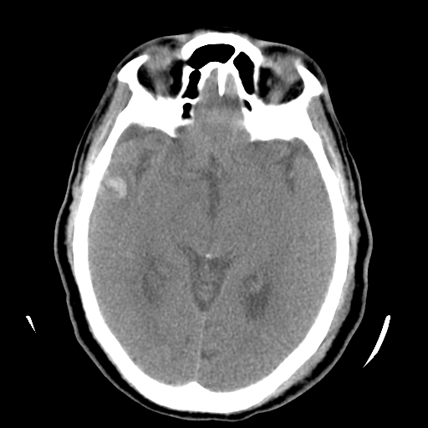
Diagnosis?

Slide 49
Cerebral Contusion
Intraparenchymal
“Coup-Contrecoup”
Look for:
  Scalp contusion
  Halo of edema

Slide 50
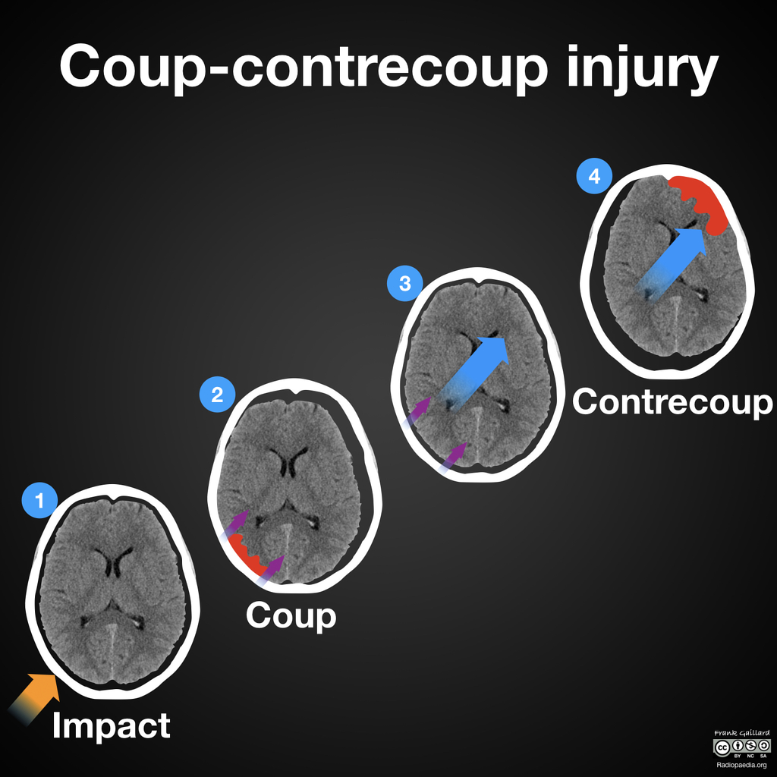
Case courtesy of A.Prof Frank Gaillard, Radiopaedia.org, rID: 55561
Notes:
external blow (yellow arrow)
skull is accelerated away from blow (purple arrows) and impacts upon the underlying brain (coup)
brain is also accelerated away from blow (blue arrow)
brain then impacts upon the skull opposite the initial blow (contrecoup)

Slide 51
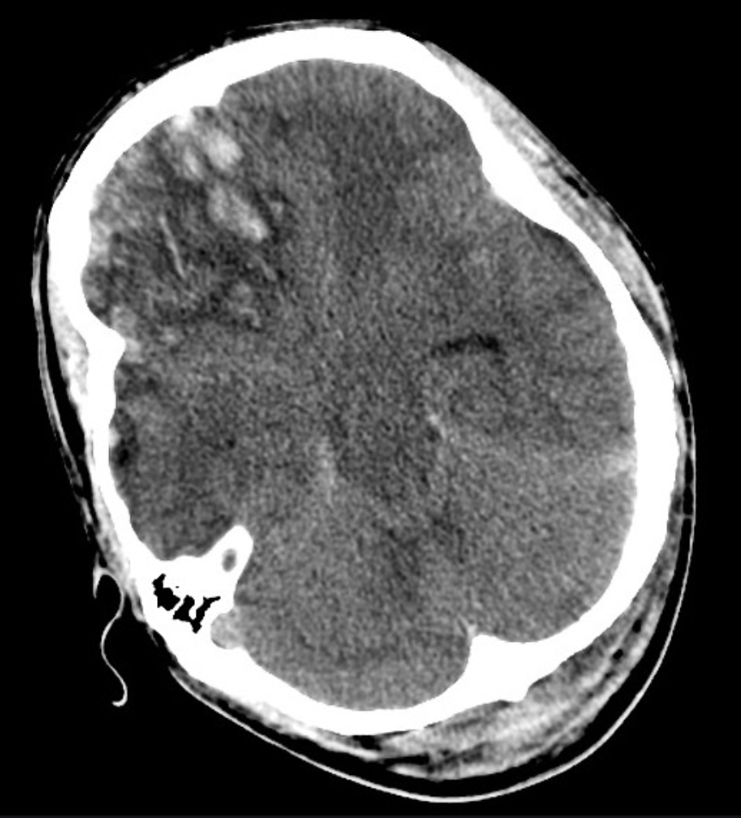
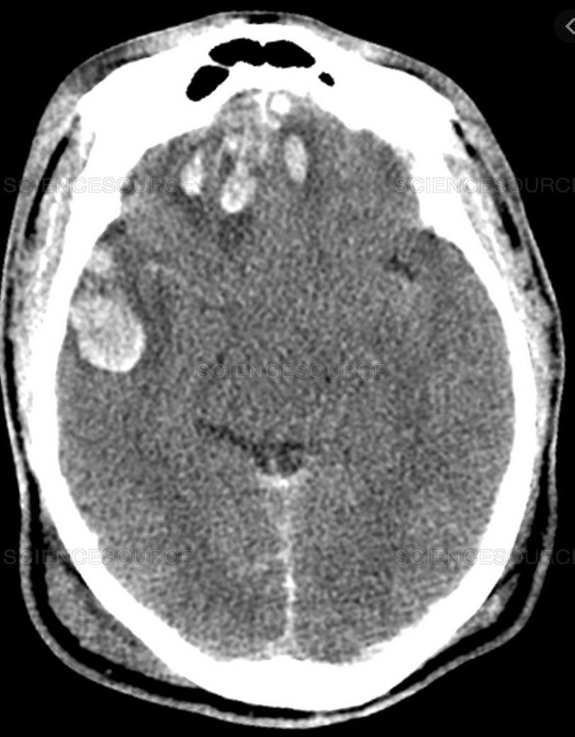
Cerebral Contusions

Slide 52
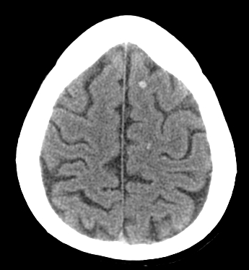
Diagnosis?

Slide 53
Subcortical Injury
Shear-Strain forces
  Rapid acceleration and/or deceleration of the brain
  Penetrating vessels
  Diffuse axonal injury (DAI)
“Tip of the iceberg”
  Consider MRI
Neurological deficits may be out of proportion to degree of injury visible on CT

Slide 54
Diffuse Axonal Injury
MRI demonstrates increased foci of T2 signal within the white matter
(right frontal parasaggital white matter on this T2 sequence) →

Slide 55
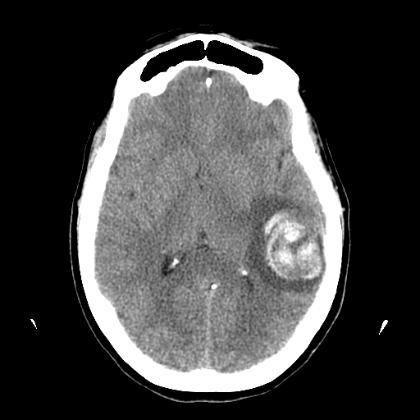
Diagnosis?

Slide 56
Intracerebral Hemorrhage
Hypertension
  Most common
  Characteristic Locations
IF LOBAR BLEED:
  SEARCH for underlying cause!
  MRI/MRA/MRV
  DSA or CTA
  Repeat imaging if negative initially
Look for:
  EXPANSION
  UNDERLYING LESION

Slide 57
Goals & Objectives
Understand indications for acute head imaging
Review basic neuroanatomy
Identify traumatic pathology
Review cases

Slide 58

Code Stroke!
Patient presents with headache, somnolence, and weakness. Code stroke is called. The CT shows intracranial hemorrhage. In what space is the blood located?
Intraparenchymal
Subarachnoid
Subdural
Epidural
Intraventricular
Notes:
Next case
This patient comes in with headache, somnolence, and weakness. A code stroke is called.
You see intracranial hemorrhage
Where is it?

Slide 59
Code Stroke!
Patient presents with headache, somnolence, and weakness. Code stroke is called. The CT shows intracranial hemorrhage. In what space is the blood located?
Intraparenchymal
Subarachnoid
Subdural
Epidural
Intraventricular
Notes:
Subarachnoid--remember the subarachnoid space includes the CSF spaces around the cerebrum (in the sulci), and around the brainstem and cerebellum (the basal cisterns)
--In this case you can see blood in the sylvian fissures, and the interhemispheric fissure, as well as the quadrigeminal cistern, and suprasellar/interpeduncular cistern
(note the hyperdensities in the lateral ventricles are normal calcifications in the choroid plexus).

Slide 60

Case
A 23-year-old male falls while rock-climbing, and strikes his head on a rock. He initially complained of head pain only, but now presents to the hospital comatose.
What is the most likely cause of arterial bleeding:
Skull fracture
Shear forces
Anticoagulation
Penetrating injury
Notes:
This is a two step question--to answer this question, you need to first be able to distinguish in what space the hematoma is—then you have to know the common mechanisms of the types of hemorrhages.
-A skull fracture can cause an epidural hematoma by injuring a meningeal vessel.
-Shear forces can cause axonal injury and small parenchymal hemorrhage.
-Shear forces and anticoagulation can both cause subdural hemorrhage.
-A penetrating injury, like a bullet wound, would cause hemorrhage in multiple spaces.
So is this hematoma epidural or subdural?

Slide 61
Case
A 23-year-old male falls while rock-climbing, and strikes his head on a rock. He initially complained of head pain only, but now presents to the hospital comatose.
What is the most likely cause of arterial bleeding:
Skull fracture
Shear forces
Anticoagulation
Penetrating injury
Notes:
This is an epidural hematoma, which is associated with injury to the meningeal vessels, often caused by skull fracture.
Clues:
-the hematoma is lens shaped (not crescent shaped).
-The hematoma does not cross suture lines (it extends to the lambdoidal suture posteriorly and the sphenofrontal suture anteriorly).

Slide 62

Case
A 65-year-old male with atrial fibrillation falls after tripping on the sidewalk. He can’t remember hitting his head, but reports a headache and seems sleepy and confused.
What is the most likely source of bleeding:
Meningeal artery
Cerebral artery
Bridging cortical vein
Superior sagittal sinus
Notes:
This is another two step question—a common tactic for imaging questions on USMLE--to answer the question, you have to identify the abnormality, but then also know something else about the abnormality.
A—MMA hemorrhage will lead to epidural hematoma
B—a cerebral artery (i.e. MCA or ACA) hemorrhage will lead to subarachnoid hemorrhage
C—hemorrhage from a bridging cortical vein will lead to subdural hematoma
D—hemorrhage directly from the SSS would only occur in cases of severe trauma with fracture and dural tearing—likely leading to multi-spatial hemorrhage
So is this hematoma epidural or subdural?

Slide 63
Case
A 65-year-old male with atrial fibrillation falls after tripping on the sidewalk. He can’t remember hitting his head, but reports a headache and seems sleepy and confused.
What is the most likely source of bleeding:
Meningeal artery
Cerebral artery
Bridging cortical vein
Superior sagittal sinus
Notes:
This is a subdural hematoma
Clues:
Crescent shaped
“Holohemispheric” – extends along nearly the entire right hemisphere convexity (and crosses sutures).

Slide 64
Case
Dominant classification of brain bleed?
  Cortical hemorrhage
  Subdural hemorrhage
  Intraventricular hemorrhage
  Epidural hemorrhage
Case courtesy of Dr Jeremy Jones, Radiopaedia.org, rID: 6223

Slide 65
Case
Dominant classification of brain bleed?
  Cortical hemorrhage
  Subdural hemorrhage
  Intraventricular hemorrhage
  Epidural hemorrhage
Case courtesy of Dr Jeremy Jones, Radiopaedia.org, rID: 6223

Slide 66


What intracranial injuries are present?
Right extradural hematoma and a left subdural hematoma
https://radiopaedia.org/cases/extradural-vs-subdural-haematoma-lemon-vs-banana?lang=us

Slide 67
Thanks for tuning in!
Questions?
vokv@uw.edu

